Slide 1
Sydney Clergy Conference 2024 Synodality Serving Renewal: Enabling the Holy Spirit to inspire and guide our missionary response to contemporary challenges
Archdiocese of Sydney
8-11 April 2024
Archbishop Tim Costelloe SDB

Slide 2
Part One: Synodality at the Service of Renewal
Set the question of the Synod within the context of the Australian Church
Invite reflection on the “Sydney story” in relation to Synodality
Focus our attention on the concept of journeying together
We are on a journey together –
As individuals, from the moment we were “baptised into Christ and into the Church which is Christ’s body”
As a Church, from the first gathering of his disciples by Jesus
As the Church in/of Sydney as the faithful People of God, called to discipleship, at this time and in this place

Slide 3
Part Two: Situating the Ordained Ministry within a Synodal Church.
We, as ordained ministers, are called to find our place in this long and ongoing story.
Leadership in a community of disciples of Jesus
Addressing the question of “Clericalism”: myths and realities.

Slide 4
Your Archdiocesan Mission Plan Reflect, Review, Discern, Decide, Act
Evangelisation: to call and form disciples as Jesus invites us to
Leadership: to encounter Christ and become His disciple means to be given a mission to lead others to him
Community: when we experience the joy of being in Christ together… it deepens our spiritual commitment to evangelization.
Formation: to be a disciple is to be a learner who sits at the feet of Jesus, grows in faith and understanding over time, and is sent to witness and convey to others the truth of God’s love in Christ.
Worship: It is primarily by the witness of our lives , our actions, words and way of life that the Christ we encounter in the sacred mysteries becomes present to others …

Slide 5
The question
How can the Holy People of God (laity, religious and clergy), the Church in the Archdiocese of Sydney, evangelise, lead, live together, form and worship in a way which gives concrete expression to the synodal nature and identity of the Lord’s Church?
How can the community of ordained ministry in the Church in Sydney, through embracing the invitation to consciously become a more synodal Church, find inspiration and guidance for your response to contemporary challenges?

Slide 6
Synod/Synodal/ Synodality
“Synod” is an ancient and venerable word in the Tradition of the Church, whose meaning draws on the deepest themes of Revelation. Composed of a preposition συν (with) and the noun όδός (path), it indicates the path along which the People of God walk together. Equally, it refers to the Lord Jesus, who presents Himself as “the way, the truth and the life” (Jn 14,6), and to the fact that Christians, His followers, were originally called “followers of the Way” (cf. Acts 9,2; 19,9.23; 22,4; 24,14.22).
SYNODALITY IN THE LIFE AND MISSION OF THE CHURCH
INTERNATIONAL THEOLOGICAL COMMISSION 2018
https://www.vatican.va/roman_curia/congregations/cfaith/cti_documents/rc_cti_20180302_sinodalita_en.html

Slide 7
Journeying together
So then you are no longer strangers and aliens, but you are citizens with the saints and also members of the household of God, built upon the foundation of the apostles and prophets, with Christ Jesus himself as the cornerstone. In him the whole structure is joined together and grows into a holy temple in the Lord; in whom you also are built together spiritually into a dwelling place for God (Ephesians 2:19-22).
Synodality is an eccesial task undertaken by a community of disciples (of Jesus), with a community of disciples (of Jesus) and for a community of disciples (of Jesus).

Slide 8
What is (who is) the Church?
The Church, in Christ, is in the nature of sacrament – a sign and instrument, that is, of communion with God and of unity among all people …. (LG1)
The Church – that is, the kingdom of Christ already present in mystery - grows visibly …. (LG3).
The universal Church is seen to be “a people brought into unity from the unity of the Father, the Son and the Holy Spirit” (LG 4, quoting St Cyprian).
At all times the Church carries the responsibility of reading the signs of the time and of interpreting them in the light of the gospel if it is to carry out its task ….. (G&S 4).

Slide 9
Reading … and interpreting … in the light of the Gospel.
Signs of the Times: How do we identify, then read (understand) then interpret?
What tools do we (the ecclesial reality we call the Church) bring to the task of interpretation (discernment)?
Contemporary challenges, Scriptures, Tradition,
A community (of disciples) called to a three-fold fidelity:

Slide 10
If a juggler focuses only
on one or two of the balls,
it will be impossible to keep
all of the balls “in play”.
If we, as the Church in any particular diocese,
(in this case the archdiocese of Sydney)
are to walk together into a greater fidelity to the Lord,
we must constantly seek to be attentive
to all three dimensions of our life of faith

Slide 11
The Scriptures
Long ago God spoke to our ancestors in many and various ways by the prophets, but in these last days he has spoken to us by a Son, whom he appointed heir of all things, through whom he also created the worlds. He is the reflection of God’s glory and the exact imprint of God’s very being, and he sustains all things by his powerful word.
(Hebrews 1:1-4)
I am the Way, the Truth and the Life
No-one can come to the Father except through me (John 14:6).
The absolute centrality of Jesus Christ as the centre of our faith
The gospels are the written Word of God which bear infallible witness to the living Word of God

Slide 12
If we are being called to read and interpret the sign of the times (the contemporary challenges) in the light of the gospel, this means in the light of the full revelation of Jesus Christ, the Word of God made flesh, as this Word comes to us in and through the Church which is the body (head and members) of Christ.
Reading and interpreting the signs of the times is an ecclesial task and responsibility. It is the Church, “a people brought into unity from the unity of the Father, the Son and the Holy Spirit”, which does this.
Synodality: a way of ensuring that the whole Church acts together, in communion, to discern the signs of the times.

Slide 13
The Year of Grace 2012
"We wish to see Jesus" (Jn 12:21). This request, addressed to the Apostle Philip by some Greeks who had made a pilgrimage to Jerusalem for the Passover, echoes spiritually in our ears too during this Jubilee Year. Like those pilgrims of two thousand years ago, the men and women of our own day — often perhaps unconsciously — ask believers not only to "speak" of Christ, but in a certain sense to "show" him to them. And is it not the Church's task to reflect the light of Christ in every historical period, to make his face shine also before the generations of the new millennium?
Our witness, however, would be hopelessly inadequate if we ourselves had not first contemplated his face.
(NMI 16)

Slide 14
Origins in the Year of Grace
Bishops reflecting on Novo Millennio Ineunte
The need to “do something” in and for the Church in Australia ….but what?
Plenary Council – proposed and rejected
Why? – no clear understanding of the nature of a PC; a recognition of the need to return to the basics first
Invite the Church to “go on retreat” for a year
Yer of Grace initiative announced for 2012

Slide 15
Origins in the Year of Grace (cont)
The Royal Commission into Institutional Responses to Child Sexual Abuse was a Royal Commission announced in November 2012 and established in 2013 by the Australian Government “pursuant to the Royal Commissions Act 1902 to inquire into and report upon responses by institutions to instances and allegations of child sexual abuse in Australia”.
Bishops postpone any decision regarding the follow-up to the Year of Grace in order to focus on the Royal Commission

Slide 16
Origins in the Year of Grace (cont)
Royal Commission Final Report issued in 2017
Church’s response
Return to question of follow-up to Year of Grace
Decision to convene a Plenary Council taken.
Council to be held over two sessions (2020-2021)
Initial preparations begin

Slide 17
Plenary Council
Due to Covid first Assembly postponed to 2021 and conducted on-line
Second Assembly in Sydney in June/July 2022
Listening and Dialogue phase (2018-2019)
over 220,000 people
17,457 submissions
Emergence of national themes for discernment

Slide 18
Plenary Council (cont)
Listening and Discernment phase
Emergence of national themes for discernment
How is God calling us to be a Christ-centred Church which is:
Missionary and evangelising (Evangelisation)
Inclusive, participatory and synodal (Community, Leadership))
Prayerful and Eucharistic (Worship)
Humble, healing and merciful (Community)
A joyful, hope-filled, servant community (Leadership)
Open to conversion, renewal and reform (Formation)

Slide 19
Plenary Council (cont)
The two assemblies (2021 and 2022)
The methodology of “spiritual conversations”
The emergence of consensus as expressed in the formal decrees.

Slide 20
Plenary Council Decrees
Decree 1
Reconciliation - Healing Wounds, Receiving Gifts
Decree 2
Choosing Repentance - Seeking Healing
Decree 3
Called by Christ - Sent Forth as Mission Disciples
Decree 4
Witnessing to the Equal Dignity of Women and Men

Slide 21
Plenary Council Decrees
Decree 5
Communion in Grace - Sacrament to the World
Decree 6
Formation and Leadership for Mission and Ministry
Decree 7
At the Service of Communion Participation and Mission – Governance
Decree 8
Integral Ecology and Conversion for the Sake of Our Common Home

Slide 22
Plenary Council Decrees
Decree 9
The Implementation Phase of the Fifth Plenary Council
Decree 10
The Decrees of the Fourth Plenary Council of Australia

Slide 23
Plenary Council – what next?
Awaiting Recognitio from Rome
Have no canonical binding force until this occurs
Mostly non-controversial
Many dioceses already implementing many of the elements of various decrees.

Slide 24
Synod on Synodality
Pope Francis (March 2020) announces theme of next Synod of Bishops: "For a synodal Church: Communion, participation and mission.“
Officially launches the synodal journey on 10 October 2021

Slide 25
Synodality
A certain rich man came up to Jesus “as he was setting out on his journey” (Mk 10:17). The Gospels frequently show us Jesus “on a journey”; he walks alongside people and listens to the questions and concerns lurking in their hearts. He shows us that God is not found in neat and orderly places, distant from reality, but walks ever at our side. He meets us where we are, on the often rocky roads of life. Today, as we begin this synodal process, let us begin by asking ourselves – all of us, Pope, bishops, priests, religious and laity – whether we, the Christian community, embody this “style” of God, who travels the paths of history and shares in the life of humanity. Are we prepared for the adventure of this journey? Or are we fearful of the unknown, preferring to take refuge in the usual excuses: “It’s useless” or “We’ve always done it this way”?
Celebrating a Synod means walking on the same road, walking together. Let us look at Jesus. First, he encounters the rich man on the road; he then listens to his questions, and finally he helps him discern what he must do to inherit eternal life. Encounter, listen and discern. I would like to reflect on these three verbs that characterize the Synod.
HOMILY OF HIS HOLINESS POPE FRANCIS
St Peter's Basilica Sunday, 10 October 2021

Slide 26
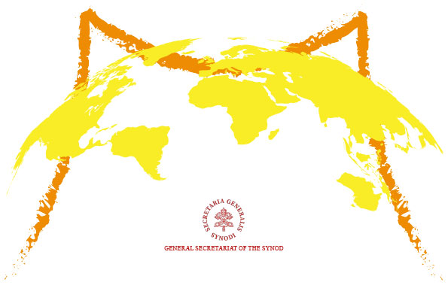
The Synodal Journey
World-wide consultation eventually produces synthesis documents from the Bishops Conferences.
“Periti” meet in Frascati for a month to study and summarise the results and produce a synthesis document: Enlarge the space of your tent.

Slide 27
Enlarge the Space of your Tent
Introduction
1. The experience of the synodal journey
1.1 “The fruits, seeds and weeds of synodality”
1.2 Our common baptismal dignity
2. Listening to the Scriptures
3. Towards a missionary synodal Church
3.1 Listening that becomes welcoming
3.2 Sisters and brothers for mission
3.3 Communion, participation and co-responsibility
3.4 Synodality takes shape
3.5 Synodal life and liturgy
4. The next steps
4.1 A journey of conversion and reform
4.2 Methodology for the Continental Stage

Slide 28
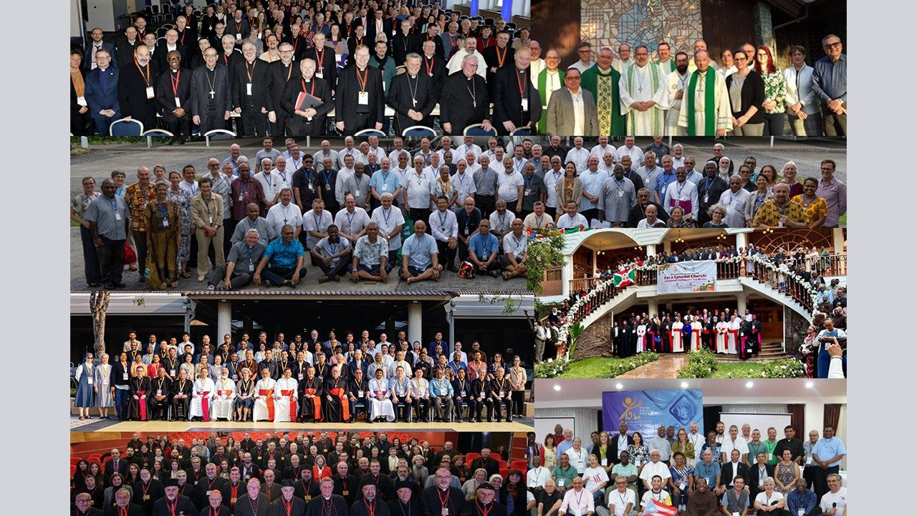

Slide 29
Continental feedback leads to Instrumentum Laboris
The Instrumentum Laboris is a working document for the forthcoming synod on synodality. It consists of two main sections that will guide the discernment of those present at the first session of the Synod in October 2023. The three priority issues that will be at the centre of the work of the Synodal Assembly in October 2023 are:
1. The question of how to grow in communion by welcoming all, no one excluded, in fidelity to the Gospel.
2.The question of concrete ways for co-responsibility, recognising and valuing the contribution of each baptised person in view of the common mission.
3.
The identification of structures and dynamics of governance through which to articulate participation and authority over time in a missionary synodal Church

Slide 30
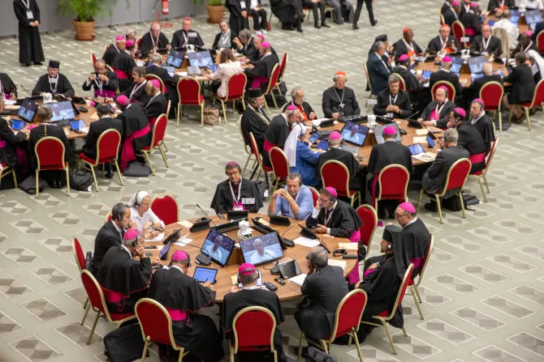
Synod on Synodality – First Assembly (October 2023)

Slide 31
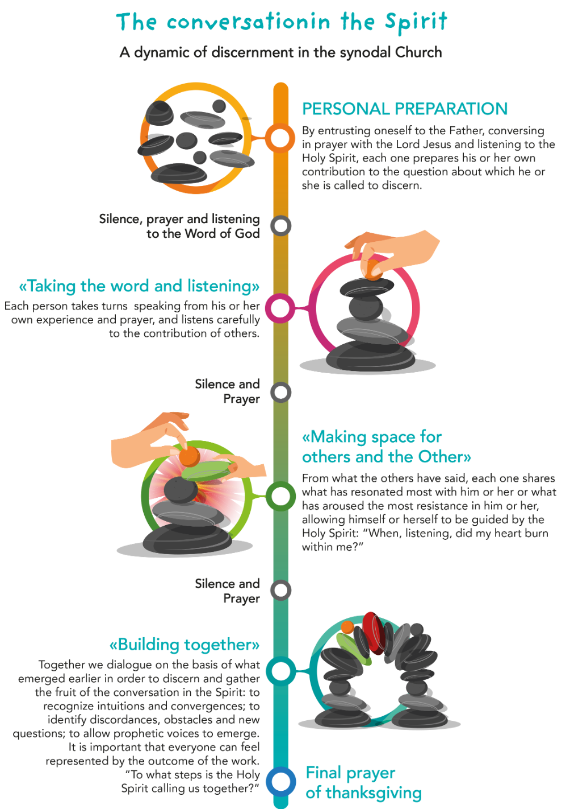

Slide 32
From the Instrumentum Laboris
“How can Conversation in the Spirit, which opens up the dynamism of community discernment, contribute to the renewal of decision-making processes in the Church? How can it be drawn more centrally into the formal life of the Church and so become an ordinary practice?”
“What changes in canon law are needed to facilitate this?”

Slide 33
Discernment – in theory and in practice
A willingness to discern, and a capacity to do so, are at the heart of the project of renewal in the Church today.
Discernment is that process of responding to the questions and intuitions that arise in our minds and hearts, individually and collectively, as we engage with our faith in dialogue with others.
Discernment is ultimately about searching for God’s will, whether that be for me as an individual or for us as a community of faith.

Slide 34
Discernment – some prompts from Scripture
You must have in you the same mind that was in Christ Jesus (Phil 2:5).
Do not be conformed to this world, but be transformed by the renewing of your minds, so that you may discern what is the will of God—what is good and acceptable and perfect (Rom 12:2).
But he (Jesus) turned and said to Peter, ‘Get behind me, Satan! You are a stumbling-block to me; for you are setting your mind not on divine things but on human things’ (Matt 16:23).
You hypocrites! You know how to interpret the appearance of earth and sky, but why do you not know how to interpret the present time? (Luke 12:56, 57)

Slide 35
The Experience of the Plenary Council
Framing the Fundamental question
Initial form of the question: What needs to happen, needs to change, needs to be modified, needs to be abandoned, needs to be preserved, as the Church seeks to move forward and remain relevant in our present context? What do I want for the Church today and into the future?
Final form of the question: What do you think God is asking of us in the Church in Australia at this time?

Slide 36
How do we go about “discovering” God’s will for us?
What are the criteria for discernment?
We listen to God by listening to each other ….
The meaning of the journey to which we are all called is above all that of discovering the face and form of a synodal Church, in which “everyone has something to learn. The faithful people, the College of Bishops, the Bishop of Rome: all listening to each other, and all listening to the Holy Spirit, the ‘Spirit of truth’ (Jn 14:17), in order to know what He ‘says to the Churches’ (Rev 2:7).”
FRANCIS, Address at the Ceremony Commemorating the 50th Anniversary of the Institution of the Synod of Bishops.

Slide 37
Not a search for the majority opinion, still less an exercise in being brow-beaten or intimidated by the loudest voices.
But a respectful, “non-defensive” listening, which accepts willingly that the Holy Spirit, like the wind which blows where it will, may be found in the seemingly most unlikely of places (cf. John 3:8) and heard in the most unlikely of voices (cf. for example, Matt 15:26).
In such an open, non-defensive listening, there is no room for pre-determined solutions or the promoting of personal agendas.

Slide 38
If a juggler focuses only
on one or two of the balls,
it will be impossible to keep
all of the balls “in play”.
If we, as the Church in our diocese, are to walk together
into a greater fidelity to the Lord,
we must constantly seek to be attentive
to all three dimensions of our life of faith: Scripture, Tradition,
the Signs of the Times.

Slide 39
Listening to all the voices ……
The role of women in the Church and the possibility of ordaining women deacons.
Among members of the assembly, the report said, some thought the idea of women deacons would be a break with tradition, while others insisted it would "restore the practice of the Early Church," including at the time of the New Testament, which mentions women deacons.
"Others still, discern it as an appropriate and necessary response to the signs of the times, faithful to the Tradition, and one that would find an echo in the hearts of many who seek new energy and vitality in the Church," it said. But, the report added, some members thought that would "marry the Church to the spirit of the age”.
Catholic News Service

Slide 40
Non-defensive listening will prevent us from dismissing those whose opinion is different to ours, and even perhaps disturbing for us, as either examples of people stuck in the past and frightened of change or ignorant of the Church's teaching and determined to tear down the Lord’s Church and create one of their own.
Non-defensive listening will receive what is heard with an open heart, recognise the sincerity and good will of the other, search for what is positive in what is being said , and remain open to a deepening of our understanding of a topic which challenges us.
Non-defensive listening will be open to the challenge of evaluating both what “I hear” and what I find both attractive and negative in the light of the three-fold fidelity:
Is what I am hearing in harmony with the Gospel and the teaching of the Scriptures?
Is what I am hearing in continuity with the Tradition or a (seemingly) radical break from it?
Is what I am hearing a valid response to the Signs of the Times interpreted in the light of the Gospel, or is it a concession to values which are not in harmony with the gospels?

Slide 41
Non-defensive listening will be open to the possibility that, in spite of my own profound convictions on a particular matter, there is no consensus emerging as a fruit of spiritual discernment and so we all must remain open to further developments and insights, which may or may not confirm the positions which I presently hold.
To develop authentic ecclesial discernment in these and other areas, it is necessary to approach these questions in the light of the Word of God and Church teaching, properly informed and reflected upon.” (Final Report of Synod First Assembly)

Slide 42
Listening and Discernment
The Synod then offers us the opportunity to become a listening Church, to break out of our routine and pause from our pastoral concerns in order to stop and listen. To listen to the Spirit in adoration and prayer. Today how much we miss the prayer of adoration; so many people have lost not only the habit but also the very notion of what it means to worship God! To listen to our brothers and sisters speak of their hopes and of the crises of faith present in different parts of the world, of the need for a renewed pastoral life and of the signals we are receiving from those on the ground.
ADDRESS OF HIS HOLINESS POPE FRANCIS FOR THE OPENING OF THE SYNOD
Saturday, 9 October 2021

Slide 43
What must we do brothers?
Now when they heard this, they were cut to the heart and said to Peter and to the other apostles, ‘Brothers, what should we do?’ Peter said to them, ‘Repent, and be baptized every one of you in the name of Jesus Christ so that your sins may be forgiven; and you will receive the gift of the Holy Spirit. For the promise is for you, for your children, and for all who are far away, everyone whom the Lord our God calls to him (Acts 2:37-39)
This is the question you, as the ordained ministers of this archdiocese, are being called to answer.

Slide 44
Part Two: Situating the Ordained Ministry within a Synodal Church.
We, as ordained ministers, are called to find our place in this long and ongoing story.
Leadership in a community of disciples of Jesus
Addressing the question of “Clericalism”: myths and realities.

Slide 45
Clericalism and the Synod
“Enlarge the Space of Your Tent”
Chapter 3: Towards a Missionary Synodal Church
The reports also reflect on the difficulty of listening deeply and accepting being transformed by it. They highlight the lack of communal processes of listening and discernment, and call for more training in this area. Furthermore, they point to the persistence of structural obstacles, including: hierarchical structures that foster autocratic tendencies; a clerical and individualistic culture that isolates individuals and fragments relationships between priests and laity; sociocultural and economic disparities that benefit the wealthy and educated; and the absence of “in-between” spaces that foster encounters between members of mutually separated groups (p.33).

Slide 46
“It is important to build a synodal institutional model as an ecclesial paradigm of deconstructing pyramidal power that privileges unipersonal managements. The only legitimate authority in the Church must be that of love and service, following the example of the Lord” (CE Argentina). P. 57.
The tone of the reports is not anti-clerical… they signal the importance of ridding the Church of clericalism so that all its members, including priests and laity, can fulfil a common mission. Clericalism is seen as a form of spiritual impoverishment, a deprivation of the true goods of ordained ministry, and a culture that isolates clergy and harms the laity. This culture separates us from the living experience of God and damages the kinship relations of the baptised, producing rigidity, attachment to legalistic power and an exercise of authority that is power rather than service (p.58).

Slide 47
Synod Synthesis Report - October 2023
Clericalism stems from a misunderstanding of the divine call, viewing it more as a privilege than a service, and manifesting itself in the exercise of power in a worldly manner that refuses to allow itself to be accountable. This distortion of the priestly vocation needs to be challenged from the earliest stages of formation by ensuring close contact with the People of God and through concrete service-learning experiences among those most in need. The exercise of priestly ministry today cannot be conceived of except in harmony with the bishop and the presbyterate, and in profound communion with other ministries and charisms. Unfortunately, clericalism is a disposition that can manifest itself not only among ministers but also among the laity.

Slide 48
Many women expressed deep gratitude for the work of priests and bishops. They also spoke of a Church that wounds. Clericalism, a chauvinist mentality and inappropriate expressions of authority continue to scar the face of the Church and damage its communion (Par 9f).
Transparency and a culture of accountability are of crucial importance for us to move forward in building a synodal Church. We ask local churches to identify processes and structures that allow for a regular audit of how priests and deacons are carrying out roles of responsibility in the exercise of their ministry. Existing institutions, such as participatory bodies or pastoral visits, can be the starting point for this work, taking care to involve the community. Such forms must be adapted to local contexts and diverse cultures, so as not to be a hindrance or a bureaucratic burden (11k).

Slide 49
Th question of Culture. Culture and charism
Inculturation: what does this mean, require?
The Incarnation as the foundational model of inculturation.
Though he was in the form of God …..
Jesus, fully human and fully divine, becomes God among us as one of us, and “from within” affirms all that is good in humanity and confronts and challenges all that is not in harmony with God’s creative design.
Jesus as the Word of God becomes the “cultural norm” against which all other cultures (Italian, Irish, Vietnamese, corporate, clerical, diocesan, ……..) must be measured, affirming all that is good and challenging all that is not.

Slide 50
The encounter between various forms of a clerical culture and the Catholic theological understanding of the ordained ministry can assist us in the task of “reading the signs of the times” in relation to our way of living the ordained ministry within the Church and discerning its compatibility with the “Word made flesh”.

Slide 51
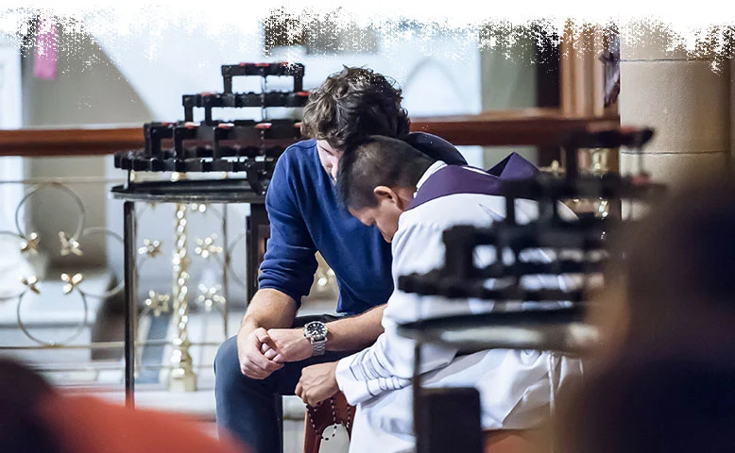
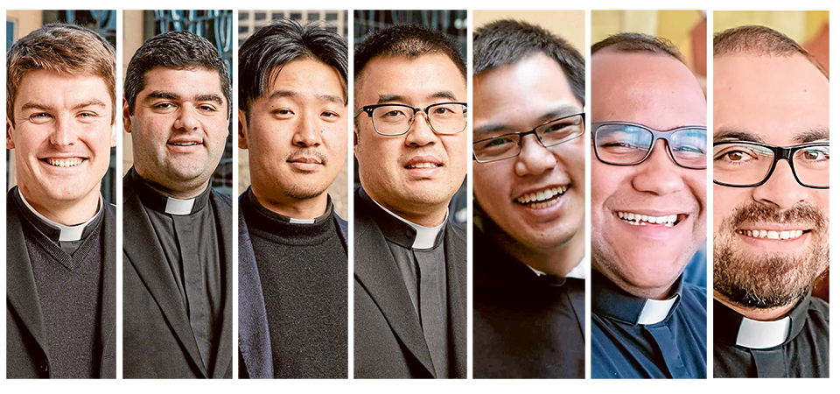
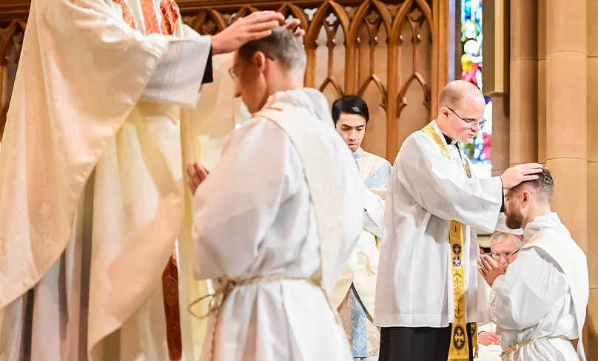
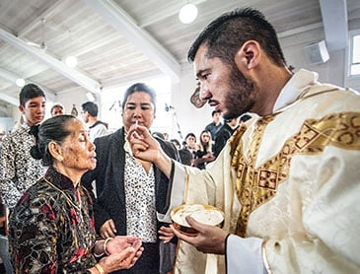
The Catholic Priest – Who is he? Who am I? Who are we?
What does/should
our relationship
with our people
look like?

Slide 52
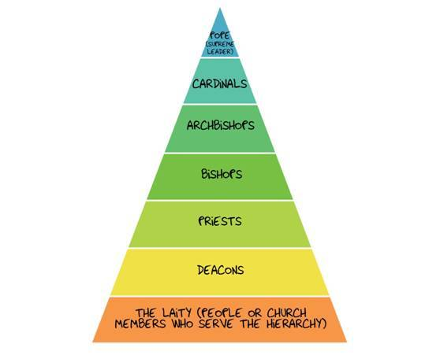

Slide 53
Christ the one, unique priest
The Community of disciples,
made the Body of Christ through Baptism and the Eucharist,
are in Christ a priestly people,
sharers in the one priesthood of Christ.
The ordained ministry of bishops and priests
Icons of Jesus - head, shepherd and spouse
Enablers of the baptismal priesthood of all believers

Slide 54
What is this one priesthood of Christ? What “makes” Christ a priest?
Priests offer sacrifice in order to re-establish right relations with God.
The offering of the sacrifice (first fruits) symbolises the desire of the people to be reconciled with God.
The offering of sacrifice is an act of worship and praise, an offering of humble obedience, a recognition of radical dependence, a prayer for forgiveness and healing, an outward expression of an inner attitude of mind and heart.
Jesus (the priest) offers one perfect sacrifice on behalf of and in the name of all humanity.
Through the sharing of his priesthood, he draws us into this attitude of mind and heart and empowers us, in him, to make our lives a gift of total self-giving to God in and through our gift of ourselves to and for the good of others.
To be in Christ is to be in the priestly Christ: it is “to have the mind of Christ”.

Slide 55
The one unique priesthood of Christ is communicated to the Church
(community of the baptised) through the sacraments of initiation,
thus making the community the body of Christ and a priestly people
The Church, in Christ
a priestly people
Ordained ministry
The ordained ministry of bishops, priests and deacons,
at the service of the priestly vocation of the whole Church

Slide 56
John Paul 11
The priesthood is not an institution that exists ‘alongside’ the laity or ‘above’ it. The priesthood of bishops and priests, as well as the ministry of deacons, is ‘for’ the laity, and precisely for this reason it possesses a ‘ministerial’ character, that is to say, one of ‘service.’ Moreover, it highlights the ‘baptismal priesthood,’ the priesthood common to all the faithful. It highlights this priesthood and at the same time helps it to be realised in the sacramental life (Holy Thursday Letter to Priests, 1990, par. 3).

Slide 57
For the sake of the universal priesthood of the new covenant Jesus gathered disciples during his earthly mission (cf. Lk. 10:1-12), and with a specific and authoritative mandate he called and appointed the Twelve "to be with him, and to be sent out to preach and have authority to cast out demons" (Mk. 3:14-15) (PDV Par 14).

Slide 58
Not “along side” (as though separated from)
Not “above” (as though dominating over)
But “together with” and “for the sake of”
To help realize the baptismal priesthood
“For you I am a bishop, with you I am a Christian” (St Augustine)
We do not lose our baptismal priesthood when we are ordained.

Slide 60
The parish as a priestly community
What might need to happen in your parish – what might “look” and “be” different - if this understanding of your community as a priestly people, with you as the “chief enabler”, were the organising principle of your parish community?
How could you draw others into this enabling role?
Would the way the liturgy is experienced by your people need to change?
How could the parish community be a “self-gift” of love for the community itself and for the wider community in which the parish lives?

Slide 61
The earth is the Lord’s
and all that is in it, the world,
and those
who live in it (Ps 24:1)
But you are a chosen race,
a royal priesthood,
a holy nation,
God’s own people,
in order that you may proclaim
the mighty acts of him
who called you out of darkness
into his marvelous light.
The Church,
The Body of Christ
in the world
“Go and make disciples
of all nations”

Slide 62
So what is this Church?
He (Christ) is the head of the body, the church; he is the beginning, the first-born from the dead, that in everything he might be pre-eminent (Col 1:18)
And he (the Father) has put all things under his (Christ’s) feet and has made him the head over all things for the church (Eph 1:22)
Hold fast to the Head, from whom the whole body, nourished and knit together through its joints and ligaments, grows with a growth that is from God (Eph 2:19).

Slide 63
In our communion with each other and in our mutuality and interdependence we are the body of Christ. This communion is grounded in our relationship with and our dependence upon Christ as our head. It is he and not us who is the source of our life.
Through our communion with Christ we find ourselves in communion with all those who are in Christ.
The cup of blessing that we bless, is it not a sharing in the blood of Christ? The bread that we break, is it not a sharing in the body of Christ? Because there is one bread, we who are many are one body, for we all partake of the one bread (1 Cor 10:16-17).

Slide 64
So what is this Church?
The bride of Christ who is the Church’s spouse
Be subject to one another out of reverence for Christ. Wives, be subject to your husbands, as to the Lord. For the husband is the head of the wife as Christ is the head of the Church, his body, and is himself its Savior. As the Church is subject to Christ, so let wives also be subject in everything to their husbands. Husbands, love your wives, as Christ loved the Church and gave himself up for her.

Slide 65
For no man ever hates his own flesh, but nourishes and cherishes it, as Christ does the Church, because we are members of his body.“ For this reason a man shall leave his father and mother and be joined to his wife, and the two shall become one flesh." This mystery is a profound one, and I am saying that it refers to Christ and the Church (Eph 5:21-33).

Slide 66
The subjection of the Church to Christ is based not on domination and subsequent servitude but on profound love – love of Christ for the Church his bride and love of the Church (the community of disciples) for Christ her spouse.

Slide 67
So what is this Church?
The Church is the flock of which Christ is the Shepherd
I am the good shepherd. The good shepherd lays down his life for the sheep. The hired hand, who is not the shepherd and does not own the sheep, sees the wolf coming and leaves the sheep and runs away—and the wolf snatches them and scatters them. The hired hand runs away because a hired hand does not care for the sheep. I am the good shepherd. I know my own and my own know me, just as the Father knows me and I know the Father (John 10:11-15).

Slide 68
So what is this Church?
The body separated from the head dies
The bride separated from her husband is barren
The sheep separated from the shepherd scatter
It is Christ our head, spouse and shepherd, who gives us life, makes us fruitful and holds us together.
I am the vine, you are the branches. He who abides in me, and I in him, he it is that bears much fruit, for apart from me you can do nothing (John 15:5).

Slide 69
Ordained Ministry
The sacrament of orders is the sacramentalising of the Church’s radical dependence on Christ as its head, as its shepherd and as its spouse.
Through the ordained ministry the Church retains and gives expression to its vital and essential communion with and radical dependence on Christ for its life, fruitfulness and unity.
The ordained priest (bishop and presbyter) acts “in persona Christi capitis” so that the whole Church can be “alter Christus” for the world.

Slide 70
A “high theology” of ordained ministry
Can it lead to a new clericalism?
Undoubtedly yes
How do we avoid this danger?
We must remember who it is of whom we are, individually and together, the sacramental signs: it is Christ’s priesthood in which we participate – it is his priesthood we must exercise.
How did Christ exercise its priesthood?

Slide 71
When he had washed their feet, and taken his garments, and resumed his place, he said to them, "Do you know what I have done to you? You call me Teacher and Lord; and you are right, for so I am. If I then, your Lord and Teacher, have washed your feet, you also ought to wash one another's feet. For I have given you an example, that you also should do as I have done to you. (John 13:12-15).

Slide 72
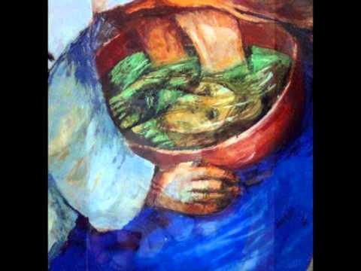
How will people recognize Christ the head in us?
When they see our faces reflected in the water
with which we humbly wash their feet.

Slide 73
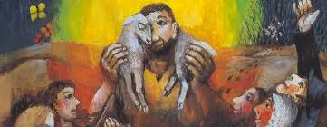
How will people recognize Christ the Good Shepherd in us?
When we reach out tenderly to those who are lost
and bear the burden of their confusion and sorrow
with them and for them.

Slide 74
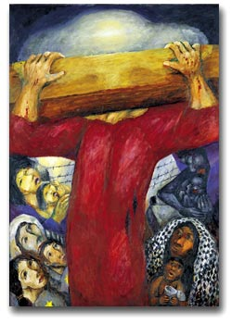
How will people recognize Christ
the loving spouse in us?
When we break our bodies
and spill our blood for them, giving ourselves
up for them as Christ gave himself up for all.

Slide 75
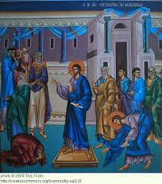
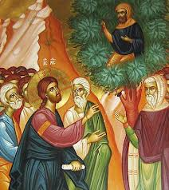
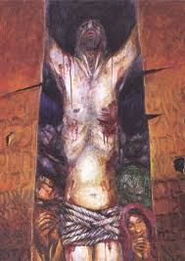
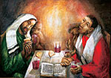
Christ the model for the ordained ministry
“Zacchaeus, make haste
and come down;
for I must stay
at your house today.”
Neither do I condemn you
While he was yet at a distance,
his father saw him and had compassion,
and ran and embraced him
and kissed him (Luke 15:20)
Father, forgive them,
for they don’t know
what they are doing
Stay with us Lord
for evening is
approaching

Slide 76
For Reflection and Discussion
If the Church, the community of disciples, is a priestly people because it is “in Christ” who shares his priesthood with us ….. and if the ordained ministry is a new sharing in the priesthood of Christ to enable the Church to be this priestly people ….. what implications does this have for our ministry among God’s people?
How in practice can/should the ordained ministry be exercised to fulfil this “enabling” role?
What needs to change:
In the archdiocese?
In my parish?
In me?

Slide 77
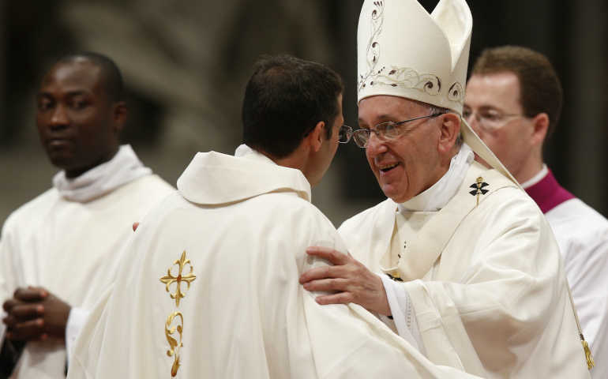

Slide 78
From Pope Francis
I want to remind priests that the confessional must not be a torture chamber but rather an encounter with the Lord’s mercy which spurs us on to do our best. A small step, in the midst of great human limitations, can be more pleasing to God than a life which appears outwardly in order but moves through the day without confronting great difficulties. Everyone needs to be touched by the comfort and attraction of God’s saving love, which is mysteriously at work in each person, above and beyond their faults and failings (EG 44).

Slide 79
I repeat for the entire Church what I have often said to the priests and laity of Buenos Aires: I prefer a Church which is bruised, hurting and dirty because it has been out on the streets, rather than a Church which is unhealthy from being confined and from clinging to its own security. I do not want a Church concerned with being at the centre and which then ends by being caught up in a web of obsessions and procedures. If something should rightly disturb us and trouble our consciences, it is the fact that so many of our brothers and sisters are living without the strength, light and consolation born of friendship with Jesus Christ, without a community of faith to support them, without meaning and a goal in life. More than by fear of going astray, my hope is that we will be moved by the fear of remaining shut up within structures which give us a false sense of security, within rules which make us harsh judges, within habits which make us feel safe, while at our door people are starving and Jesus does not tire of saying to us: “Give them something to eat” (Mk 6:37) (EG 49).

Slide 80
At a time when we most need a missionary dynamism which will bring salt and light to the world, many lay people fear that they may be asked to undertake some apostolic work and they seek to avoid any responsibility that may take away from their free time. For example, it has become very difficult today to find trained parish catechists willing to persevere in this work for some years. Something similar is also happening with priests who are obsessed with protecting their free time. This is frequently due to the fact that people feel an overbearing need to guard their personal freedom, as though the task of evangelization was a dangerous poison rather than a joyful response to God’s love which summons us to mission and makes us fulfilled and productive. Some resist giving themselves over completely to mission and thus end up in a state of paralysis and acedia (EG 81).

Slide 81
Another feature of a good homily is that it is positive. It is not so much concerned with pointing out what shouldn’t be done, but with suggesting what we can do better. In any case, if it does draw attention to something negative, it will also attempt to point to a positive and attractive value, lest it remain mired in complaints, laments, criticisms and reproaches. Positive preaching always offers hope, points to the future, does not leave us trapped in negativity. How good it is when priests, deacons and the laity gather periodically to discover resources which can make preaching more attractive! (EG 159)

Slide 82
In a culture paradoxically suffering from anonymity and at the same time obsessed with the details of other people’s lives, shamelessly given over to morbid curiosity, the Church must look more closely and sympathetically at others whenever necessary. In our world, ordained ministers and other pastoral workers can make present the fragrance of Christ’s closeness and his personal gaze. The Church will have to initiate everyone – priests, religious and laity – into this “art of accompaniment” which teaches us to remove our sandals before the sacred ground of the other (cf. Ex 3:5). The pace of this accompaniment must be steady and reassuring, reflecting our closeness and our compassionate gaze which also heals, liberates and encourages growth in the Christian life (EG 169).

Slide 83
To be evangelizers of souls, we need to develop a spiritual taste for being close to people’s lives and to discover that this is itself a source of greater joy. Mission is at once a passion for Jesus and a passion for his people. When we stand before Jesus crucified, we see the depth of his love which exalts and sustains us, but at the same time, unless we are blind, we begin to realize that Jesus’ gaze, burning with love, expands to embrace all his people. We realize once more that he wants to make use of us to draw closer to his beloved people. He takes us from the midst of his people and he sends us to his people; without this sense of belonging we cannot understand our deepest identity (EG 268).

